Slide 1

STACK
-an orderly pile of objects

Slide 2
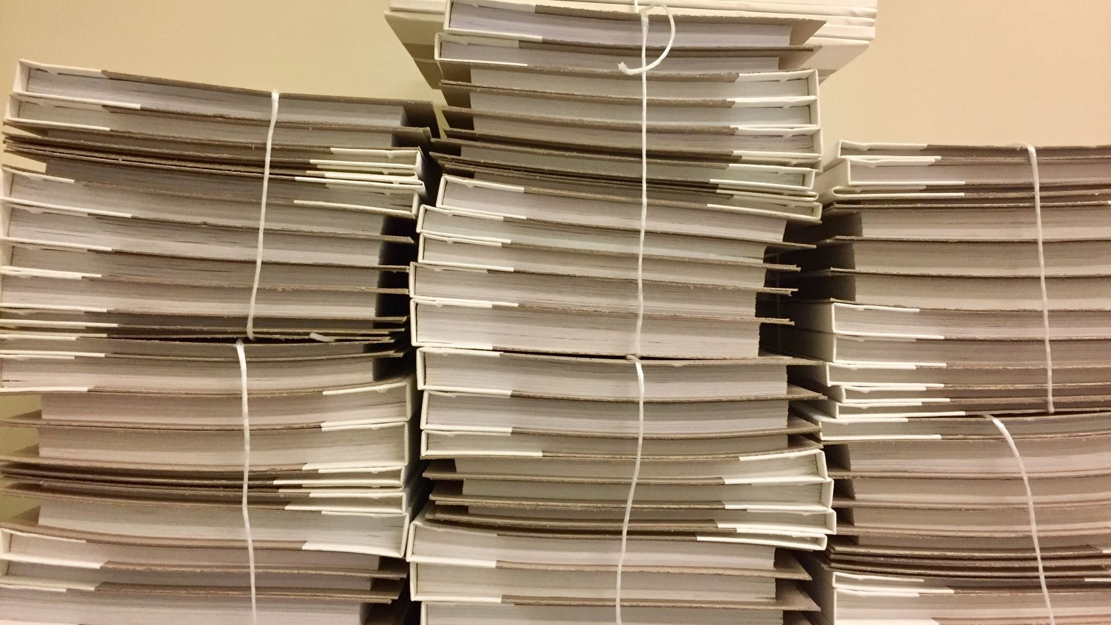
INTRODUCTION
Stack is an orderly pile of objects usually one on top of the other
Stack is the linear data structure in which the elements are inserted or deleted at only one end called top off stack.
It is based on the principle (LIFO) means last in first out.

Slide 3

Condition during STACK data entry
1>. Stack overflow : when the stack is completely full, this condition is called stack overflow. (ie. There is no more space for data entry in stack)
2>. stack underflow : when the stack is completely empty it is called stack underflow. (ie. No data in stack)

Slide 4
The Stack ADT:
CreateEmptyStack(s):- create or make stack (s) as an empty stack.
Push(s,x):- insert x at one end of stack (ie. at top of stack)
Top(s):- if stack is not empty, then retives the element from at it's top.
Pop(s):- delete the top element of stack ( pops out top element)
Isfull(s):- determine whether stack is full or not. Returns true if s is full else return false
Isempty(s):- determine whether stack is empty or not. Returns true if s is empty stack else return false
Peek :- get top data element of stack , without removing it.

Slide 5
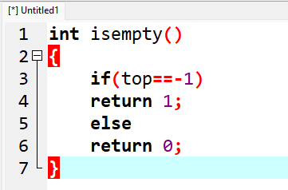
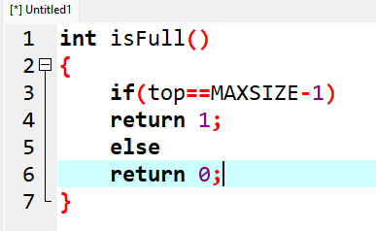
Implementation of stackempty and stackfull
->Stack empty(underflow)
->Stack full ( overflow)

Slide 6

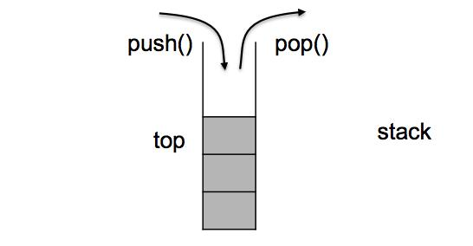
Stack operations
Push
Pop
Peek/Display

Slide 7
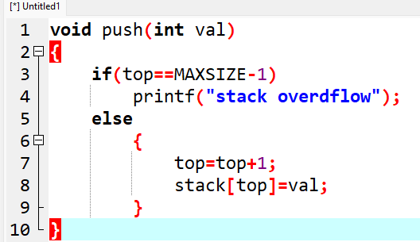
Push Operation: pushing data into stack
Algorithm:
Start
Check for stack overflow as : if top== maxsize-1 then printf "stack overflow" and exit program else increase top by 1 as set,top=top+1
Read element to be inserted say element
Set stack[top]= element
Stop

Slide 8
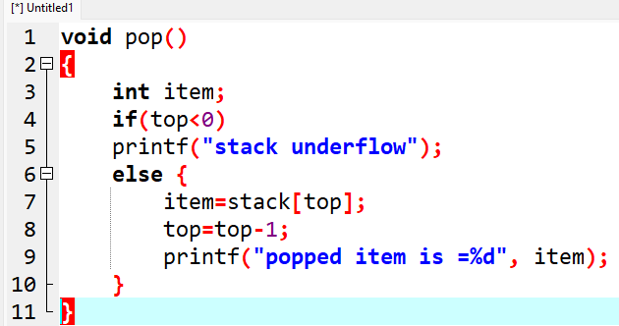
Pull Operation: pulling data from top of stack
Algorithm:
Start
Check for stack underflow as: if top<0 then , print stack underflow and exit else remove the top element and set this element to the variable as set element =stack[top] decrement top by 1 as set top=top-1
Print element as a deleted item from stack
stop

Slide 9
Peek/Display Operation: get the top element of the stack without deleting that element.
Algorithm:-
Start
Check for stack underflow as if top<0 then print stack underflow and exit the program else set i=top while(i<0){ display stack[] decrement i by 1 set i=i-1
stop

Slide 10

Thank you
:-Presentation by Ankrit Risal

